Slide 1

Rice University Boot Camps Virtual Demo Day
Gabriel pivaro

Slide 2
Python developer with a Bachelors's in Math and Ph.D. in Electrical Engineering. Certified in data analytics and visualization from Rice University with advanced skills in Python, MATLAB, and Excel, SQL database, web application. Proven records of applying statistical analysis, explanatory, and predictive modeling to generate simulations to support academic research and business analysis. Passionate to solve complex problems that require mathematical modeling, technology and even better if it can be automated by a script to save time and mitigate errors.
Skills: Statistical Analysis | Python | VBA Excel | SQL | MATLAB | Linux | Windows

Slide 3
Portfolio
AIR TRAFFIC TRACKER*
HOME WEATHER*
FIND YOUR DREAM HOME*
DISCOVER YOUR IP ADDRESS
INTERACTIVE VISUALIZATIONS
BELLY BUTTON BIODIVERSITY DASHBOARD
UFO SIGHTINGS
ETL PROJECT S&P 500*
TABLEAU DASHBOARD
MY-FINANCES*
* Full stack web applications

Slide 4
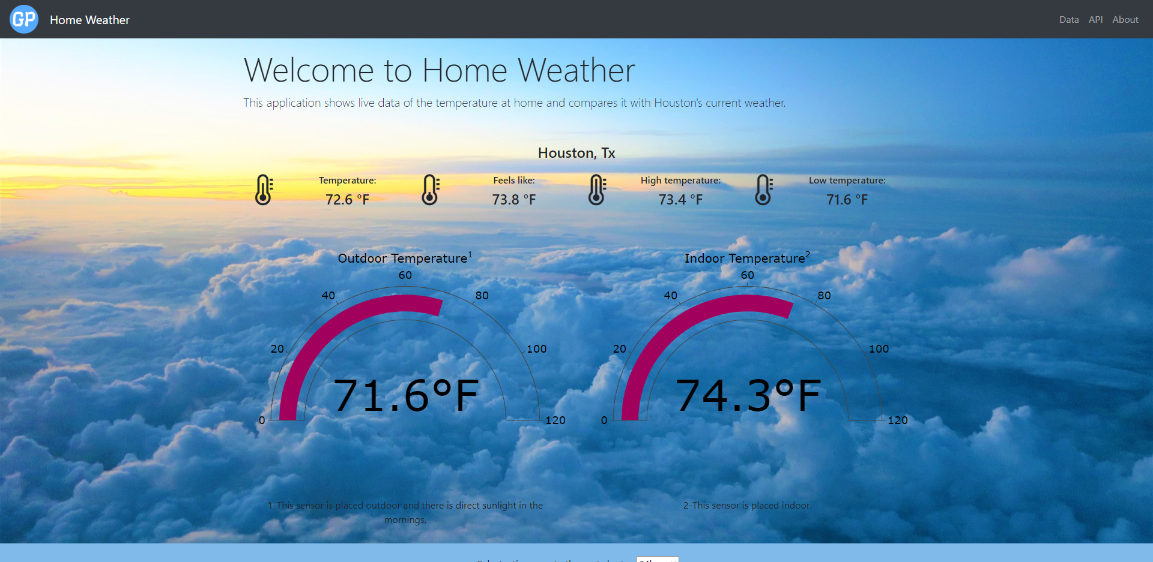

Live Weather Tracker
Problem: track local indoor and outdoor temperature and compares with the area temperature
Solution: created a web application that uses temperature sensor to track the indoor/outdoor temp
Technologies used:
Python Django
MySQL
HTML, CSS, Bootstrap
JavaScript, jQuery
API
Linux
Cloud (Linode Server)
Hardware (RaspberryPi)
https://gpivaro.com/homeweather/

Slide 5
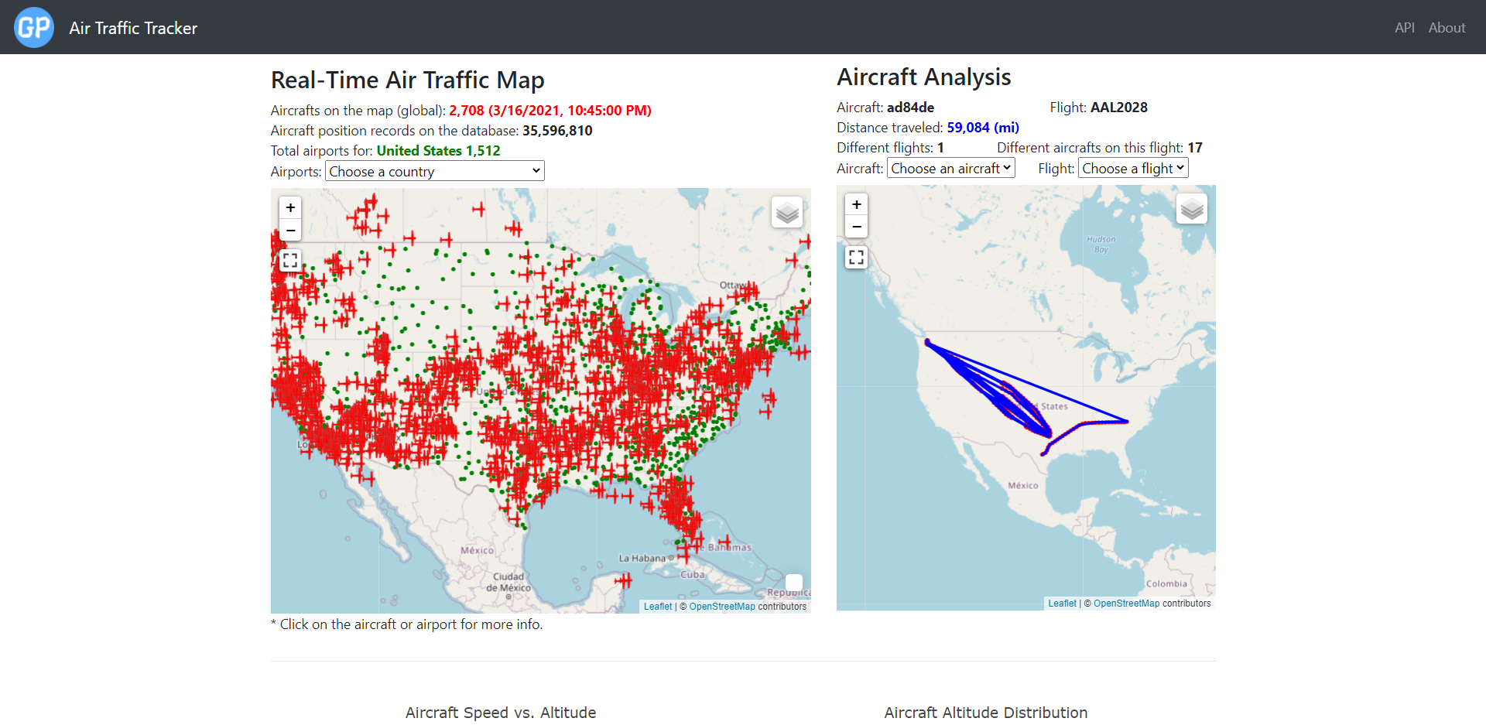
Real-Time Air Traffic Tracker
Problem: track live air traffic data to identify aspects of the global air traffic
Solution: developed a web application that acquire and store air traffic data and allow user interactivity
Technologies used:
Python Django
MySQL
HTML, CSS, Bootstrap
JavaScript, jQuery
API
Linux
Cloud (Linode Server)
https://gpivaro.com/airtraffic/

Slide 6
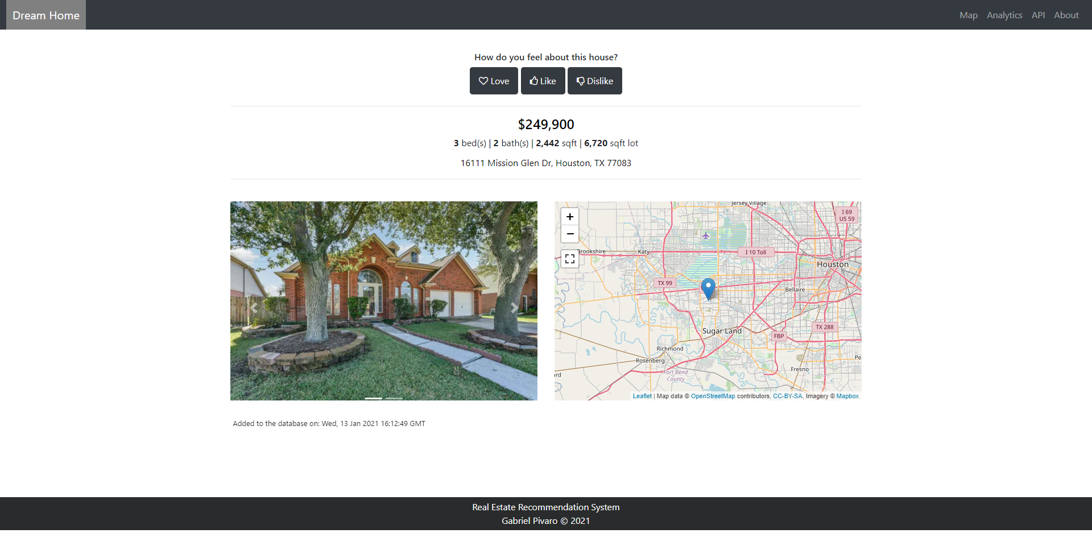
Real Estate Recommendation System
Problem: recommend the most suitable real estate saving user time to search for the perfect home
Solution: created an application to acquire data and use machine learning to make the best recommendation
Technologies used:
Python Flask
Postgres
HTML, CSS, Bootstrap
JavaScript, jQuery
API
Linux
Heroku (deployment)
https://find-your-dream-home.herokuapp.com/

Slide 7
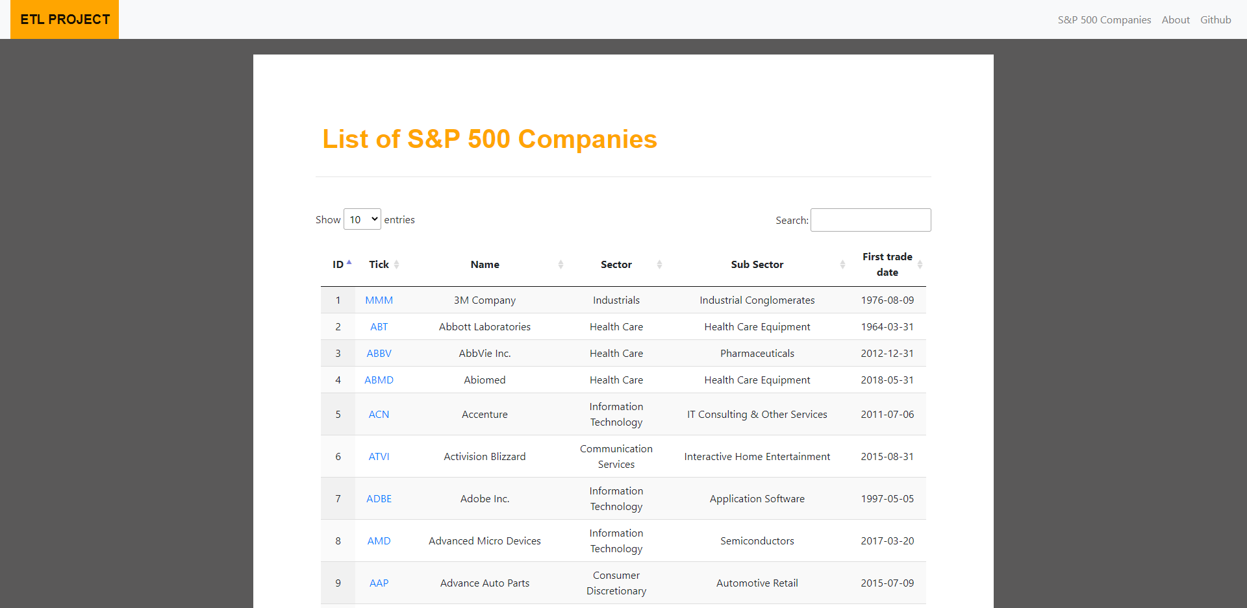
Extract, Transform, Load (ETL)
Problem: provide cleaned and formatted data about the stock price of S&P500 companies
Solution: created an application to collect, clean and store stock prices of the last 10 years
Technologies used:
Python Flask
MySQL
HTML, CSS, Bootstrap
JavaScript, jQuery
API
Linux
Heroku (deployment)
https://etl-sp500.herokuapp.com/

Slide 8
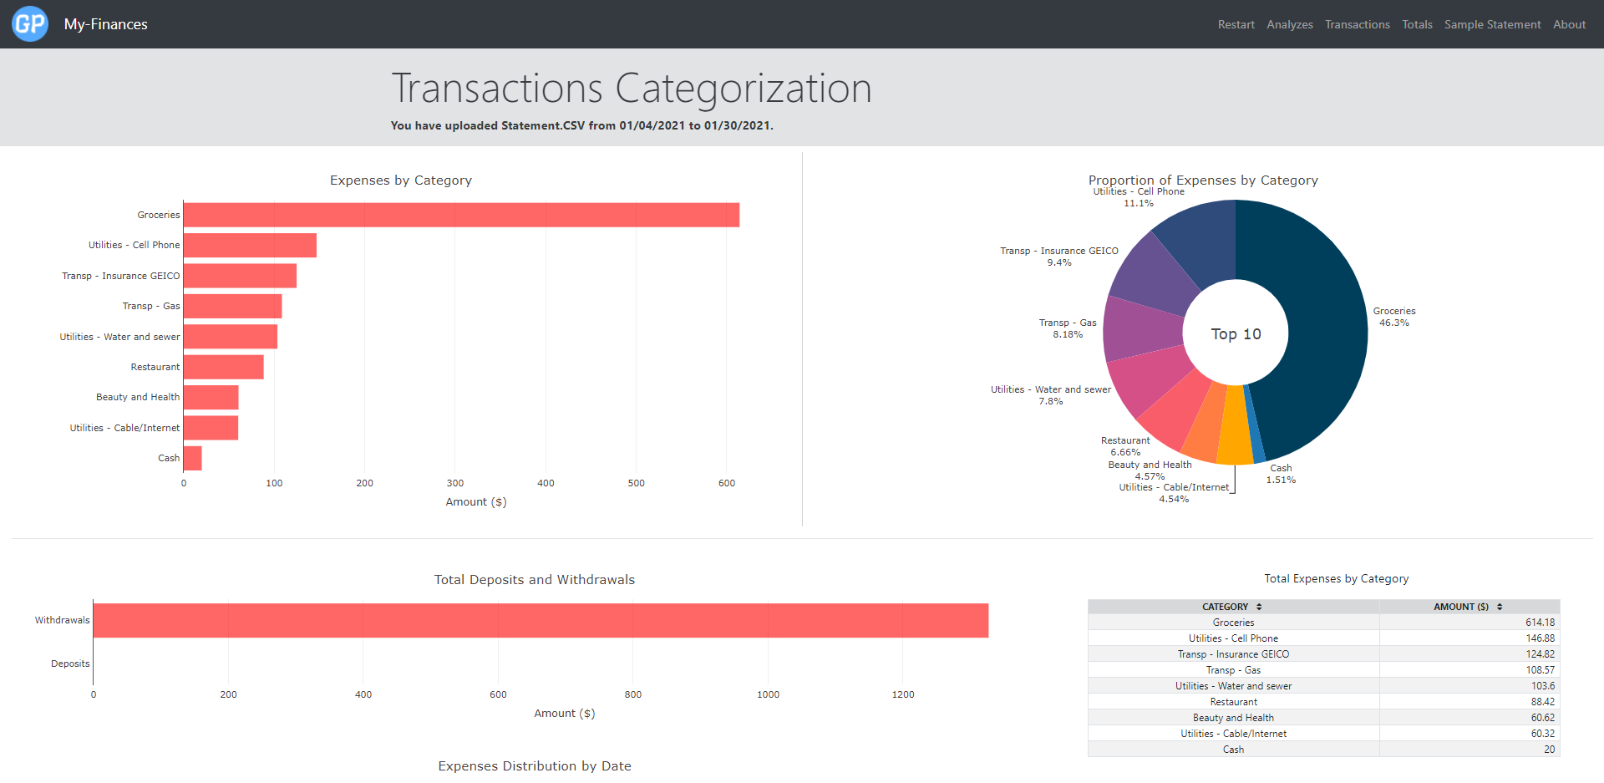
My-Finances (Bank Statement Categorization)
Problem: allow the user to save time classifying every bank transaction under the right category
Solution: created an application that classify every transaction based on the user previous categorization
Technologies used:
Python Django
MySQL
HTML, CSS, Bootstrap
JavaScript, jQuery
API
Cloud (Linode Server)
https://gpivaro.com/myfinances/

Slide 9
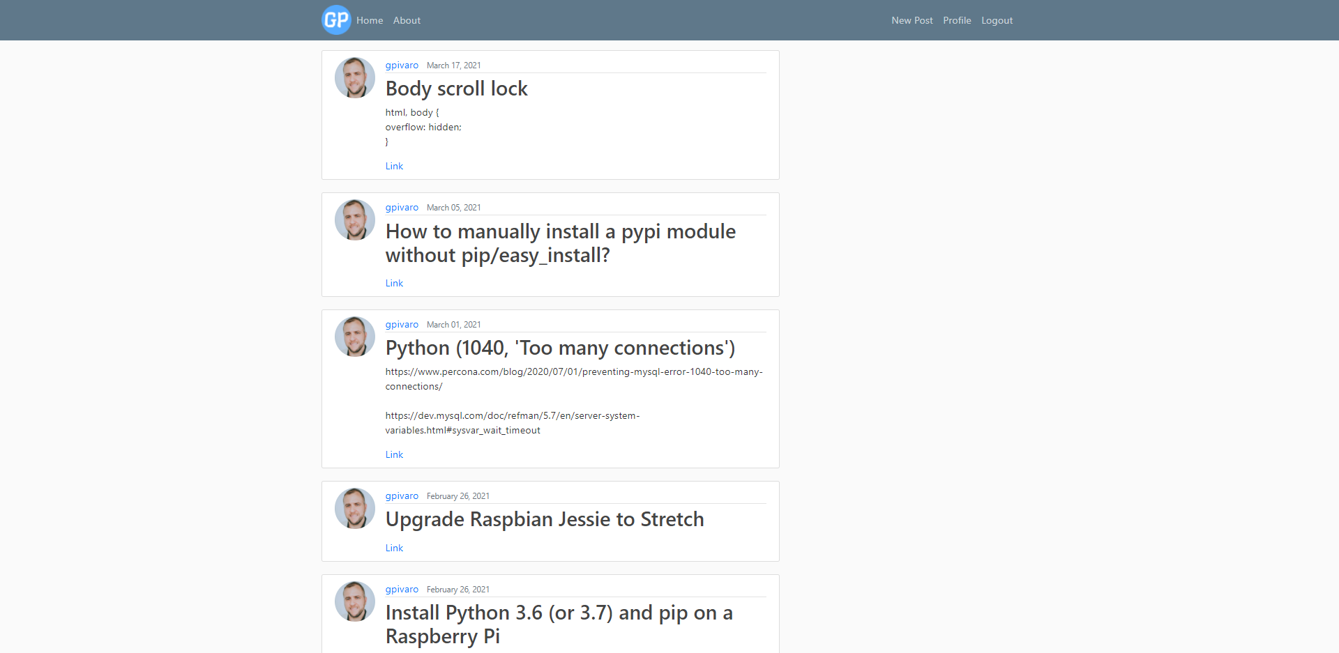
Personal Blog / Code Repo
Problem: have a personal scratch pad accessible from anywhere
Solution: created an application with authentication to help organize code snippets
Technologies used:
Python Django
MySQL
HTML, CSS, Bootstrap
JavaScript, jQuery
API
Cloud (Linode Server)
https://gpivaro.com/blog/

Slide 10
Find me:
Portfolio: gpivaro.com
LinkedIn: linkedin.com/in/gabriel-pivaro
GitHub: github.com/gpivaro
Academic research: scholar.google.com/citations?user=41Or_NUAAAAJ&hl=en

